Slide 1
Brexit and competition law
Paolo Palmigiano – Head of UK Competition, EU and Trade Practice
2 February 2021

Slide 2
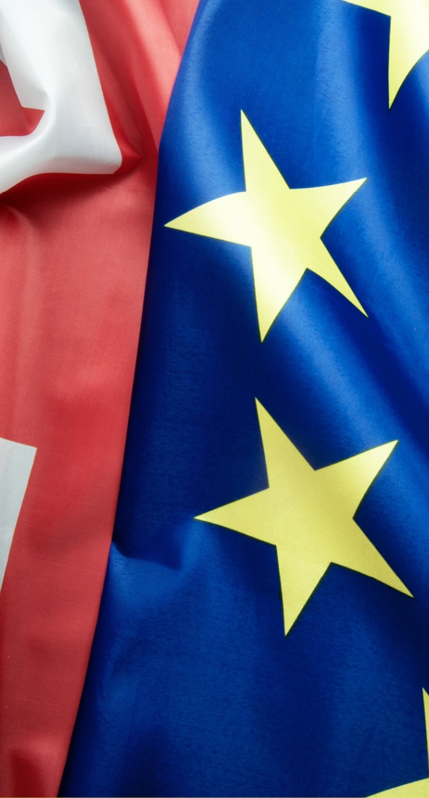
Brexit I – Horizontals and courts
    Specific provisions until the end of the transition period
    TCA requires UK to maintain competition regime
    Jurisdiction for antitrust cases
      UK CMA no longer applies Art 101/102 and not part of the ECN (but cooperation)
      New cases may result in parallel investigations
      EU Competition law still applies to UK companies selling in Europe
    Precedents
      No longer requirement to interpret UK law consistently with case law of CJEU
      New EU law not binding (divergence)
    Private enforcement : damage actions and follow on

Slide 3
Brexit II – Block exemptions & mergers
      EU Block Exemptions : retained UK law and interpretation
        Removal of EU and interstate references
        What about passive sales?
      Merger control
        No more one stop shop for merger review - If UK and EU thresholds are met, two separate filings
        UK revenue no longer included in EUMR assessment
        2/3rds test rule and more UK cases to EU
        Different timetables and waivers / disclosure
        More interventionist CMA

Slide 4
Brexit III – UK lawyers
    EU Q&A on EU-UK Trade and Cooperation Agreement
      No recognition of mutual qualifications
      EU and UK will allow lawyers from the other party to provide services relating to the practice of international law and the law of the country where they are authorised under their home title
      EU law is not considered international law but the law of the member state in which EU lawyers are established or hold their home title
    What about advise by UK lawyers on EU law? 27 different systems
    LPP
    Rights of audience at EU Courts

Slide 5

1000+ lawyers 300+ partners 28 offices 16 jurisdictions
Austria Klagenfurt | Vienna
Belgium Brussels
China Beijing | Hong Kong | Shanghai
Czech Republic Brno | Prague
France Paris
Germany Berlin | Düsseldorf | Frankfurt | Hamburg | Munich
Hungary Budapest
Netherlands Amsterdam | Eindhoven
Poland Warsaw
Slovakia Bratislava
South Korea Seoul*
UAE Dubai
Ukraine Kyiv
United Kingdom Cambridge | Liverpool | London | London TechFocus
USA New York | Silicon Valley
* In association with DR & AJU LLC
© Taylor Wessing LLP 2021
This publication is not intended to constitute legal advice. Taylor Wessing entities operate under one brand but are legally
distinct, either being or affiliated to a member of Taylor Wessing Verein. Taylor Wessing Verein does not itself provide services. Further information can be found on our regulatory page at:
www.taylorwessing.com

